Slide 1


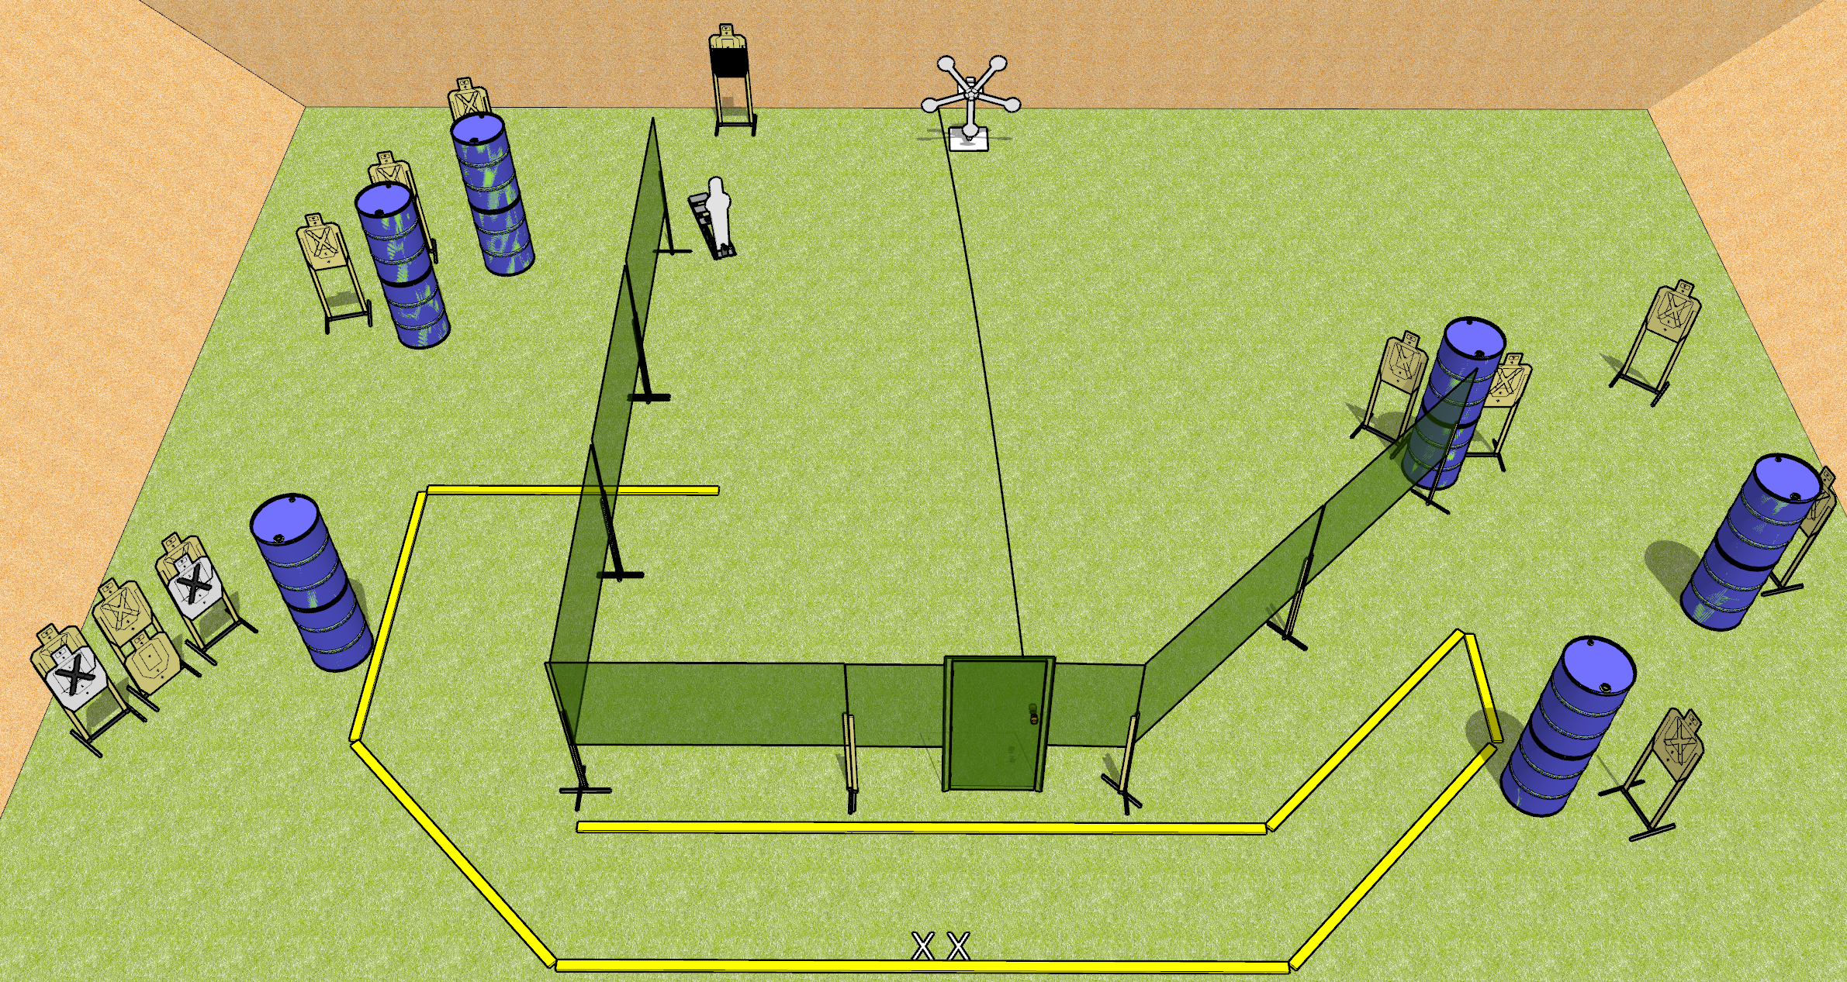
 | Dothan Gun Club – USPSA Match Keep on Spinning Course Designer : Drew Coleman
START POSITION : Standing with both feet on X’s
GUN READY CONDITION : Pistol loaded and holstered. PCC buttstock on belt, pointed in a safe direction. |  | SCORING: Comstock, 32 rounds TARGETS: 13 paper, 6 Steel SCORED HITS: Best 2 on paper, steel until down START-STOP: Audible, last shot RULES:
STAGE PROCEDURE: Engage targets as they become available from within the fault lines

